Slide 1

Decision Tree & Random Forest for Classification
MK340 - Machine Learning
Lecture: Introduction to Machine Learning
Nirmal Pregassame

Slide 2
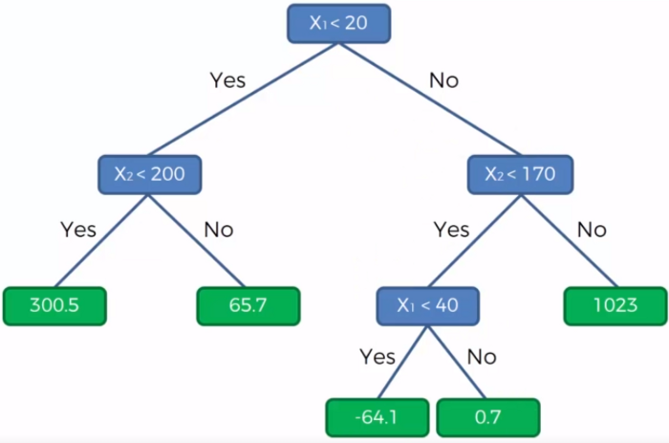
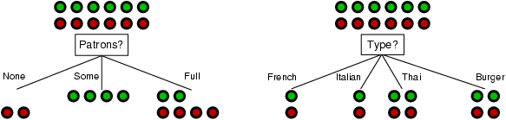
DT in Regression vs in Classification
DT in Regression
DT in Classification
Vs
=>The split is based on the numeric value of the dependent variable
=>The split is based on the homogeinity/purity of the node

Slide 3
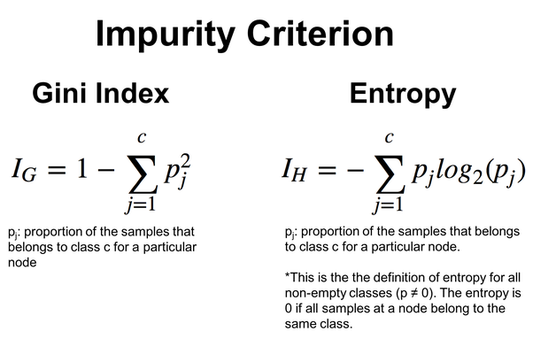
How to ensure homogeinity?
Indicators are used to calculate the purity of the population:

Slide 4
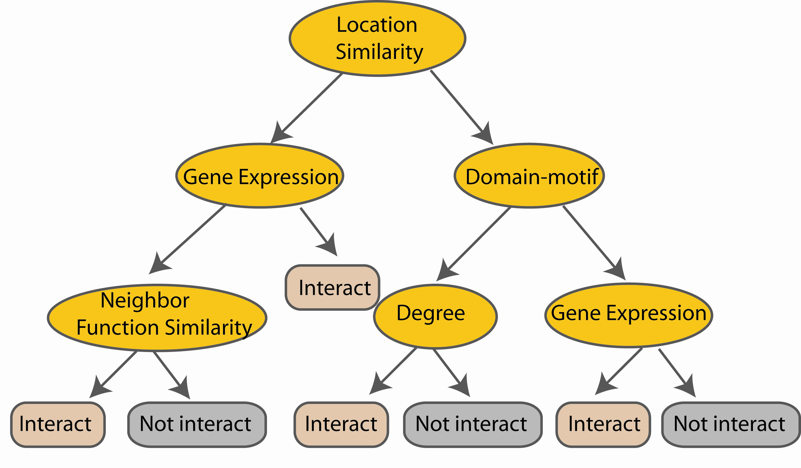
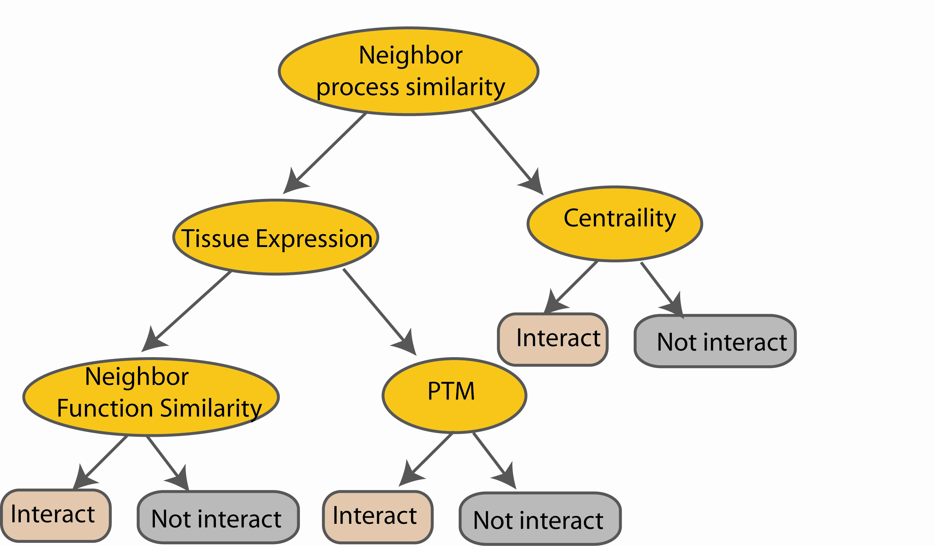
Recap Random Forest
Bootstrapping
M features
N examples
Bagging
....…
....…
Notes:
Finally the given an input data the decision is made as follows given an input data,

Slide 5
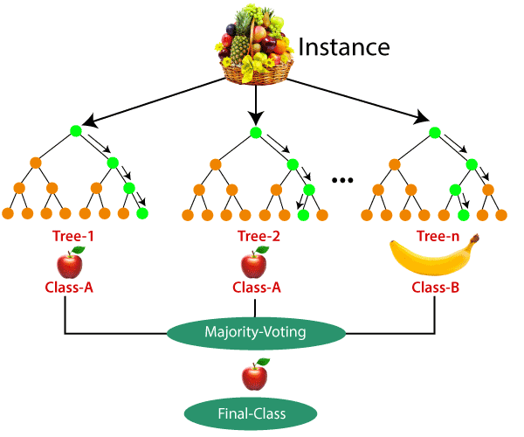
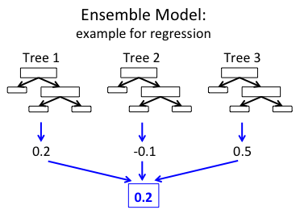
RF Regression vs Classification
RF in Regression
RF in Classification
Vs

Slide 6
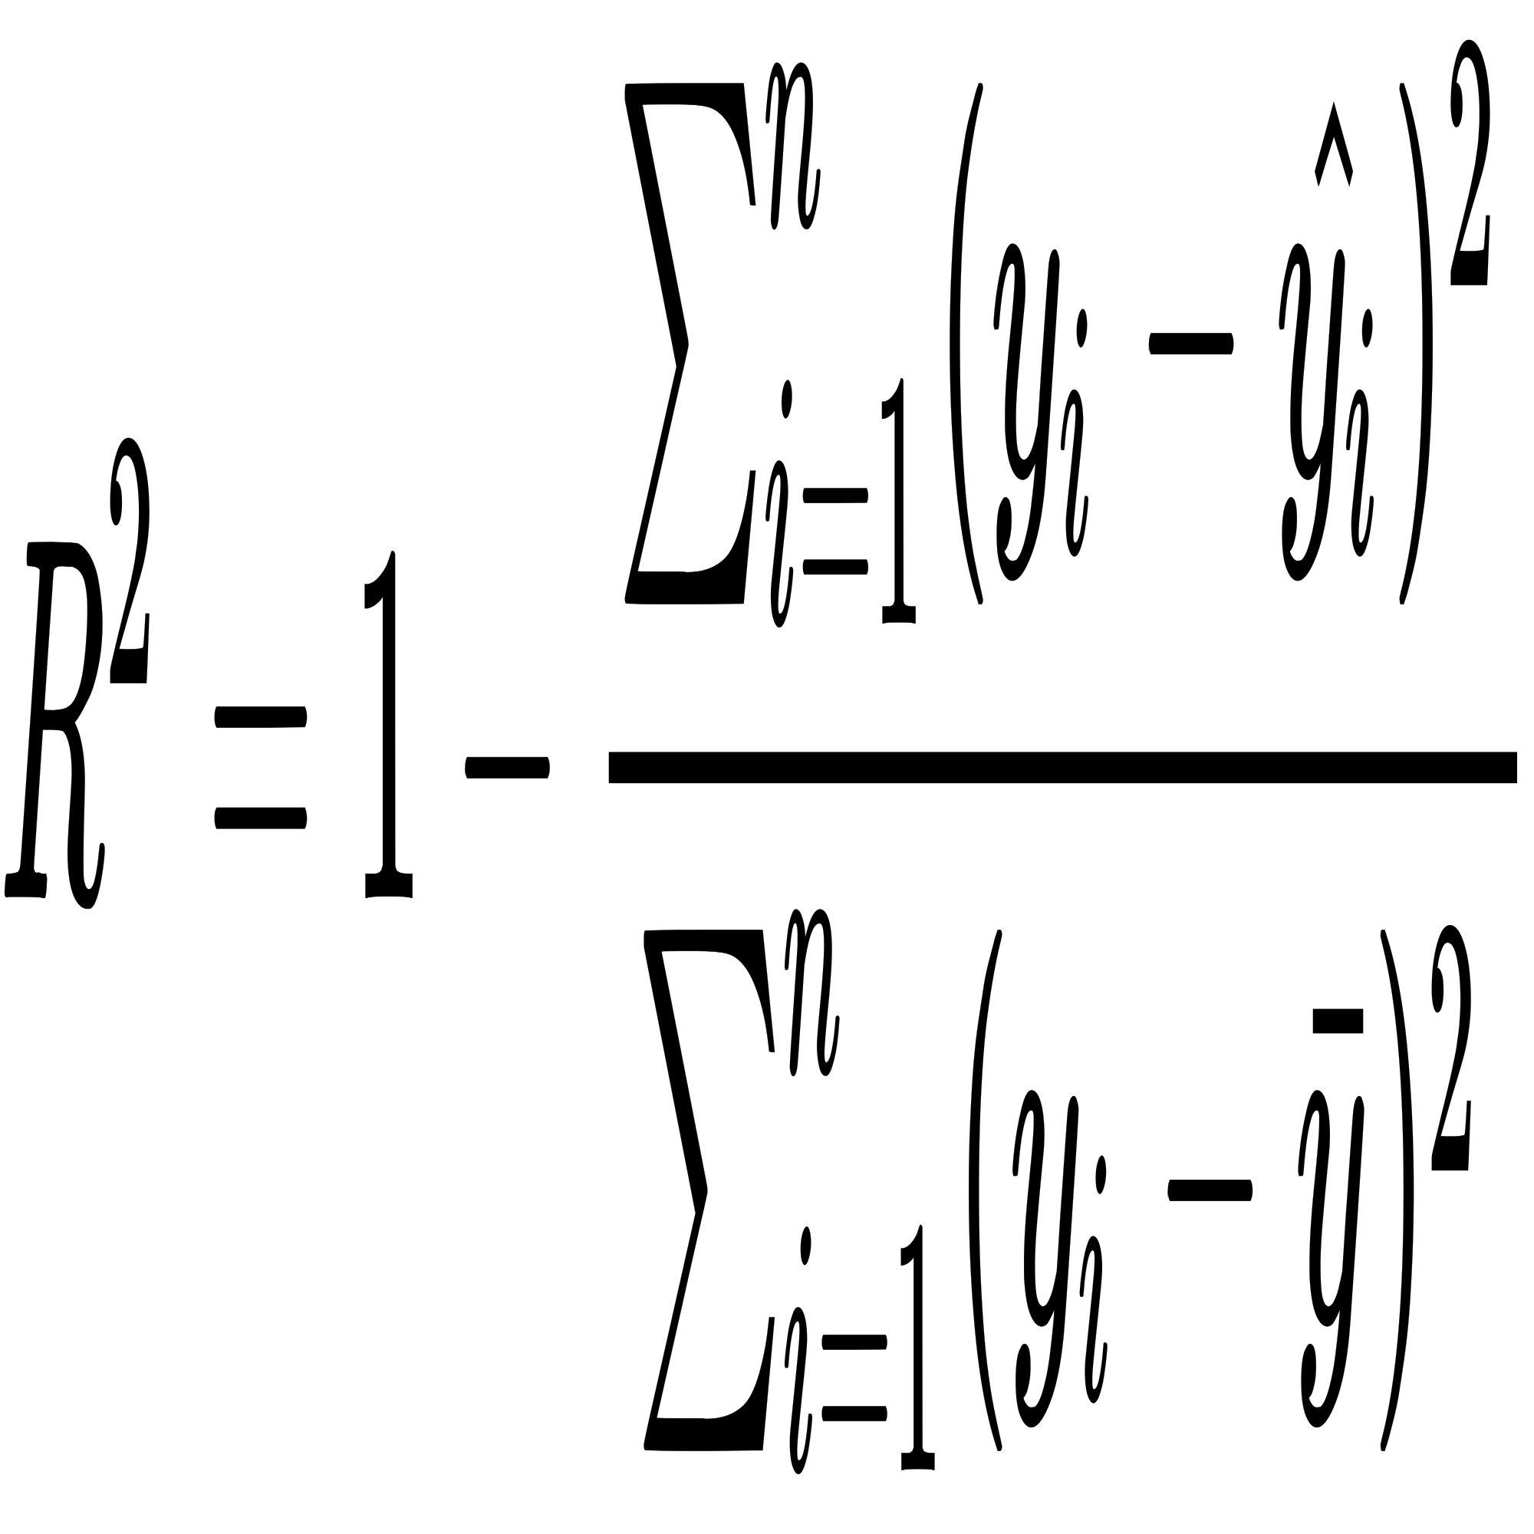
ML Scoring in Regression
R-squared value:
This scoring is very useful to evaluate a ML model for regression ; but not for a ML classifier.
Why?
because the R2 introduces the notion of distance which doesnot make sense for categories!!!

Slide 7
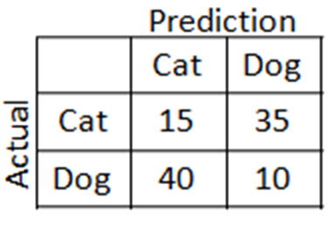
How to evaluate a ML classifier ?
Confusion matrix: Table which allows visualization of an ML classifier preformance
Confusion matrix example
The result of the predicted class
n = 100
The real class

Slide 8
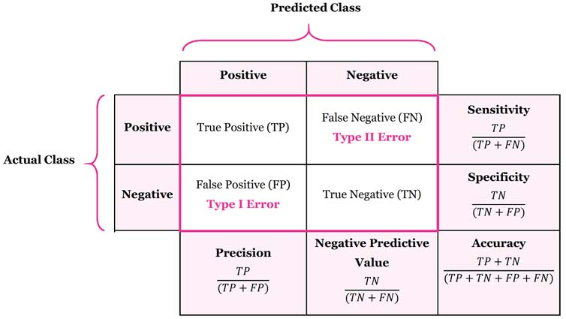
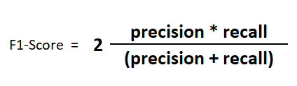
Confusion Matrix interpretation
= Recall

Slide 9
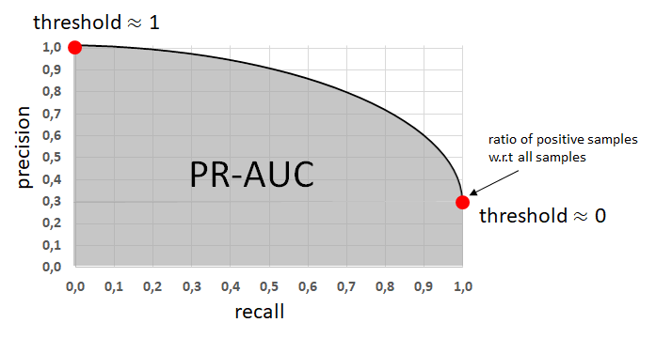
Precision Recall curve
ideal PR curve
(ideal ML classifier)
PR-AUC:
PR Area Under Curve
Worst PR curve
(bad ML classifier)
=> Depending of the threshold value (from 0 to 1), the values of the precision & recall change. The PR curve represents this change in a graph and gives indication of the performance of the ML model

